Slide 1

Monolithic Kernel Based operating System
Presented By: Shaykh Siddique
ID: 2016-1-60-053
Department of Computer Science and Engineering
East West University.

Slide 2
Overview
Introduction
Operating System, Kernel.
Types of kernel.
Monolithic Kernel Based Operating System.
Monolithic Kernel Based Operating System
Factors of monolithic kernel.
Architecture of Monolithic Kernel Based Operating System.
Monolithic kernel vs. Other kernels.
Conclusions
Advantages and disadvantages of Monolithic kernel based operating system.
Future of kernels.

Slide 3
Operating System
An operating system (OS) is system software that manages computer hardware and software resources and provides common services for computer programs.
The operating system manages a computer's hardware resources, including:
Input devices such as a keyboard and mouse
Output devices such as display monitors, printers and scanners
Network devices such as modems, routers and network connections
Storage devices such as internal and external drives
Laptops, tablets, and desktop computers all run operating systems. Some examples include versions of Microsoft Windows (like Windows 10, Windows 8, Windows 7, Windows Vista, and Windows XP), Apple's macOS (formerly OS X), iOS, Chrome OS, BlackBerry Tablet OS, and flavors of the open source operating system Linux.

Slide 4
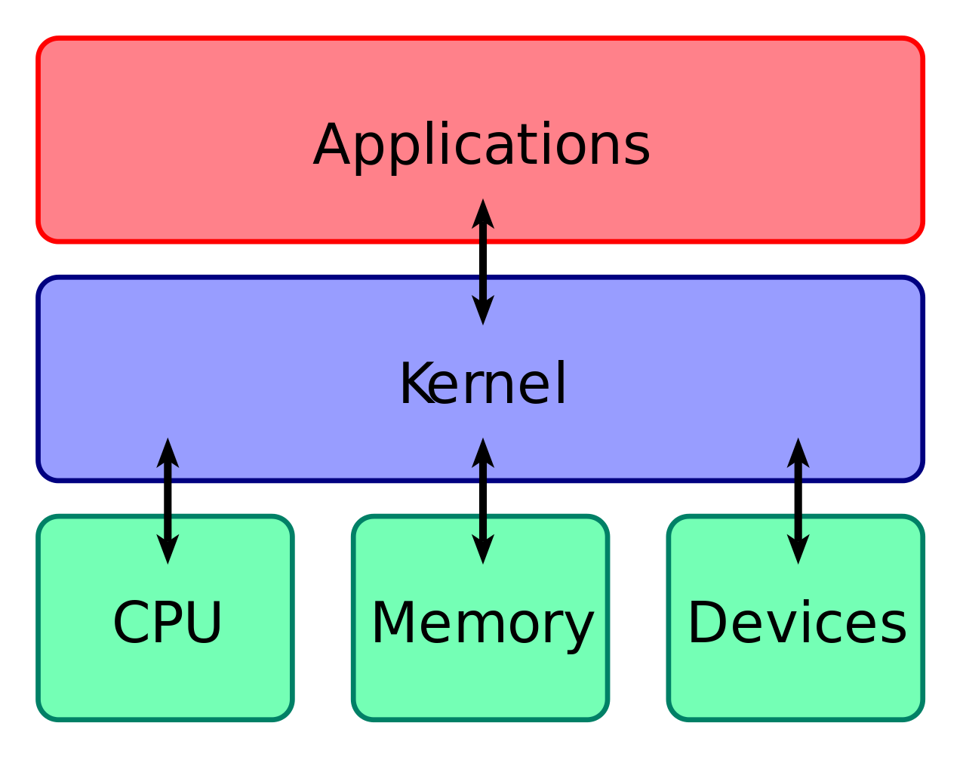
Kernel
The kernel which is called the core of a computer's operating system, with complete control over everything in the system. On most systems, it is one of the first programs loaded on start-up after the boot loader.

Slide 5
Kernel
The kernel which is called the core of a computer's operating system, with complete control over everything in the system. On most systems, it is one of the first programs loaded on start-up after the boot loader.
Operating System
Monolithic Kernel Based Operating System
Microkernel Based Operating System
Hybrid Kernel Based
Three major types of kernel based operating system.

Slide 6
Kernel Space
Any program which runs in operating system have two space mode.
User Space: It contains less privileges and limited access.
If crash it will destroy single process.
Kernel Space: Kernel space contains high privileges with all access level. If crash then the whole operating system will be interrupted.
Application
User Space
Kernel Space

Slide 7
Monolithic Kernel
A Monolithic kernel is an OS architecture where the entire operating system (which includes the device drivers, file system, and the application IPC) is working in kernel space. Monolithic kernels are able to dynamically load (and unload) executable modules at runtime.
Monolithic kernel Based Operating System : Linux, BSDs, Solaris, OS-9, AIX, HP-UX, DOS etc.
Microkernel Based Operating System: QNX, Symbian, L4Linux etc.
Hybrid Kernel Based Operating System: The Microsoft NT, Windows etc.

Slide 8
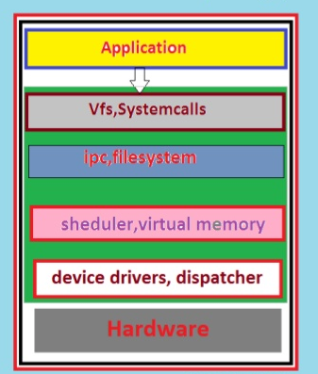
Monolithic Kernel
A monolithic kernel is an operating system software framework that holds all privileges to access input/output (I/O) devices, memory, hardware interrupts and the CPU stack.
Monolithic kernels tend to be larger than other kernels because they deal with so many aspects of computer processing at the lowest level, and therefore have to incorporate code that interfaces with many devices, I/O and interrupt channels, and other hardware operators
In monolithic kernel based operating system all VPS, System call, IPC, File system, Scheduler, Virtual Memory, Device Drivers placed with kernel.
Architecture of Monolithic kernel
User Space
Kernel Space
Machine

Slide 9
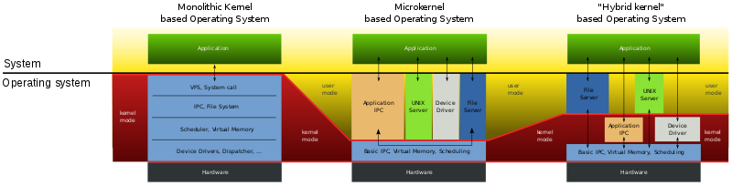
Monolithic Kernel
Microkernel based Operating System Application IPC, UNIX Server, Device Driver, File server all are in user space mode.
In hybrid kernel based operating System Application, File Server and UNIX Server are in user mode and others are in kernel space.

Slide 10
Conclusion
Faster:
Monolithic kernels are faster than microkernels. The first microkernel Mach was 50% slower than Monolithic kernel, while later version like L4 were only 2% or 4% slower than the Monolithic kernel .
Adding New features:
Adding a new feature to a monolithic system means recompiling the whole kernel, whereas with microkernels you can add new features or patches without recompiling.
Implementation:
Monolithic kernels use signals and sockets to ensure IPC, microkernel approach uses message queues. 1st gen microkernels poorly implemented IPC so were slow on context switches.
System Failure:
Monolithic kernel, if any service fails it leads to entire system failure.

Slide 11
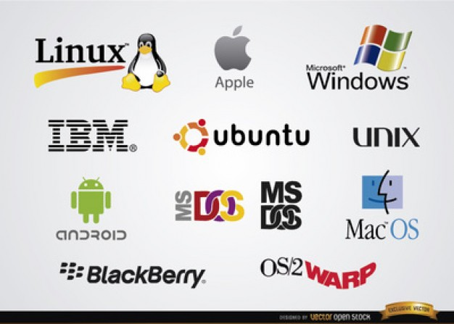
Conclusion
The seventh edition of its Linux Kernel Development Report, which offers a detailed recap of all the work done over the past couple of decades.
.
This army of talent comes from more than 1,300 companies, and the report lists a number of industry heavyweights as the main sponsors of Linux kernel development: Intel, Samsung, Red Hat, AMD, Google, ARM, Texas Instruments and more.
Monolithic kernel based operating system Linux is popular for its security, maintenance of server, real time response and other features.
The streamlined nature of Linux has kept its monolithic kernel down to an acceptable size, making it easier to add features.

Slide 12
Thank You.
Enquiry: shaykhsiddiqee@gmail.com

